Slide 1
2.3 DYNAMIC MEMORY ALLOCATION

Slide 2
Objectives
Learn how to allocate and free memory, and to control dynamic arrays of any type of data in general and structures in particular.
Practice and train with dynamic memory in the world of work oriented applications.
To know about the pointer arithmetic
How to create and use array of pointers.

Slide 3
Agenda
Dynamic memory allocation
Malloc
Calloc
Realloc
free
Pointer Arithmetic
Array of pointers

Slide 4
Introduction
While doing programming, if you are aware about the size of an array, then it is easy and you can define it as an array.
For example to store a name of any person, it can go max 100 characters so you can define something as follows:
char name[100]
But now let us consider a situation where you have no idea about the length of the text you need to store, for example you want to store a detailed description about a topic. Here we need to define a pointer to character without defining how much memory is required and later based on requirement we can allocate memory .

Slide 5
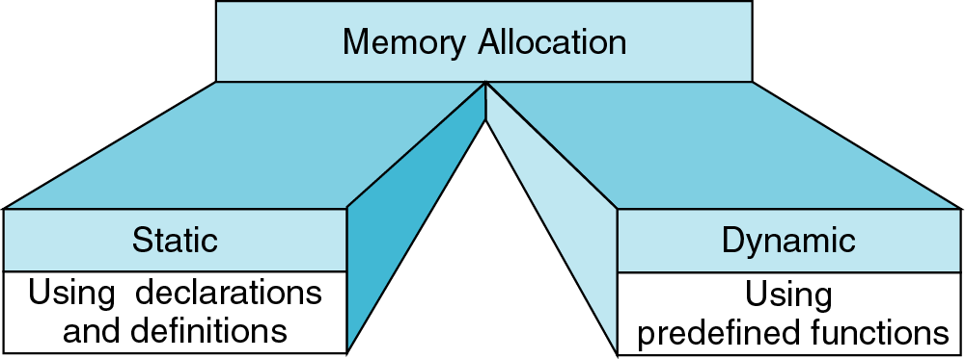
Memory Allocation Function

Slide 6
Difference between Static and Dynamic memory allocation
S.no | Static memory allocation | Dynamic memory allocation
1 | In static memory allocation, memory is allocated while writing the C program. Actually, user requested memory will be allocated at compile time. | In dynamic memory allocation, memory is allocated while executing the program. That means at run time.
2 | Memory size can’t be modified while execution. | Memory size can be modified while execution.
 | Example: array | Example: Linked list

Slide 7
Introduction
Creating and maintaining dynamic structures requires dynamic memory allocation— the ability for a program to obtain more memory space at execution time to hold new values, and to release space no longer needed.

Slide 8
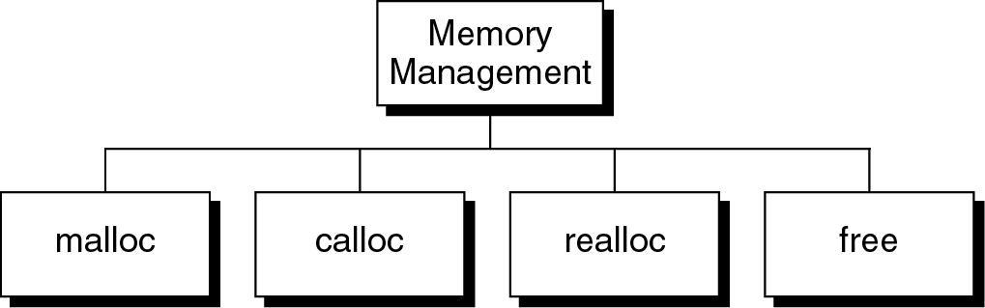
Memory Allocation Functions

Slide 9
Syntax
The following are the function used for dynamic memory allocation
void *malloc(int num);
This function allocates an array of num bytes and leave them uninitialized.
void *calloc(int num, int size);
This function allocates an array of num elements each of which size in bytes will be size.
void *realloc(void *address, int newsize);
This function re-allocates memory extending it upto newsize.
void free(void *address);
This function releases a block of memory block specified by address.

Slide 10
Block Memory Allocation (malloc)
Malloc function allocates a block of memory that contains the number of bytes specified in its parameter.
It returns a void pointer to the first byte of the allocated memory
The allocated memory is not initialized . We should therefore assume that it will contain unknown values and initialize it as required by our program.
The function declaration is as follows
void* malloc (size_t size)
If it is not successful malloc return NULL pointer.
An attempt to allocate memory from heap when memory is insufficient is known as overflow.

Slide 11
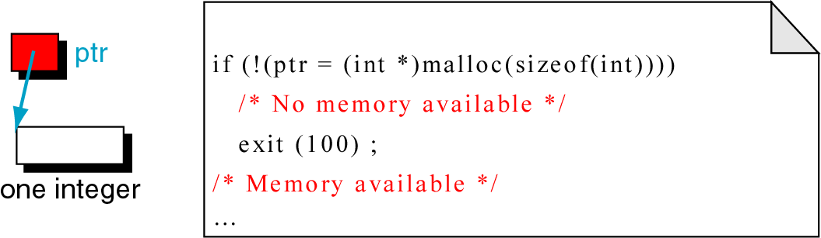
malloc
It is up to the program to check the memory overflow
If it doesn't the program produces invalid results or aborts with an invalid address the first time the pointer is used.

Slide 12
malloc
Malloc function has one more potential error.
If we call malloc function with zero size , the results are unpredictable.
It may return a NULL pointer
Never call malloc with a zero size!!!!!

Slide 13
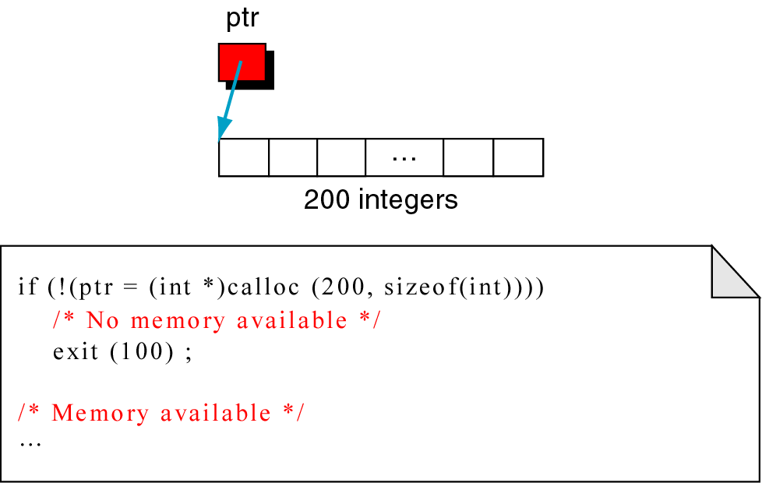
Contiguous Memory Allocation (calloc)
Calloc is primarily used to allocate memory for arrays.
It differs from malloc only in that it sets memory to null characters.
void *calloc (size_t element-count, size_t element-size)

Slide 14
Reallocation of memory(realloc)
The realloc function can be highly inefficient and should be used advisedly.
When given a pointer to the previously allocated block of memory, realloc changes the size of the block by deleting or extending the memory at the end of the block.
If memory cannot be extended because of other allocations, realloc allocates a completely new block and copies the existing memory allocation to new allocation, and deletes the old allocation.
void *realloc (void* ptr, size_t newSize)

Slide 15
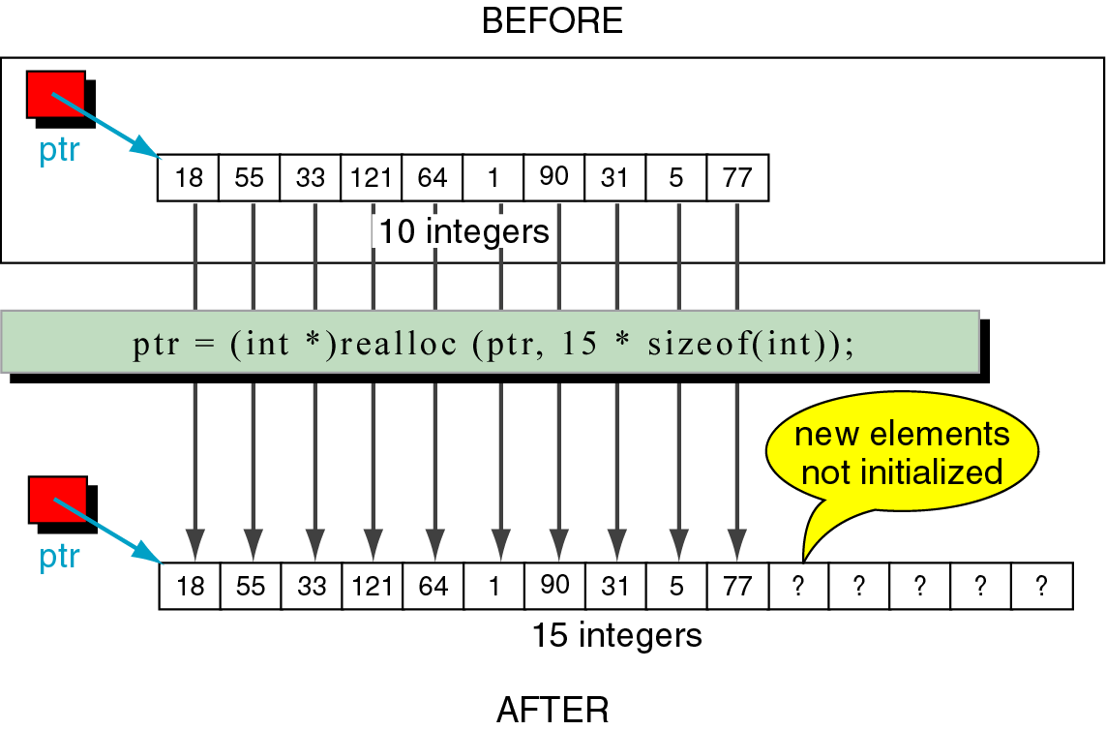
realloc

Slide 16
Releasing Memory (free)
When memory locations allocated by malloc, calloc or realloc are no longer needed, they should be freed using the predefined function free.
void free(void* ptr)
Below shows the example where first one releases a single element allocated with malloc
Second example shows 200 elements were allocated with calloc . When free the pointer 200 elements are returned to the heap.

Slide 17
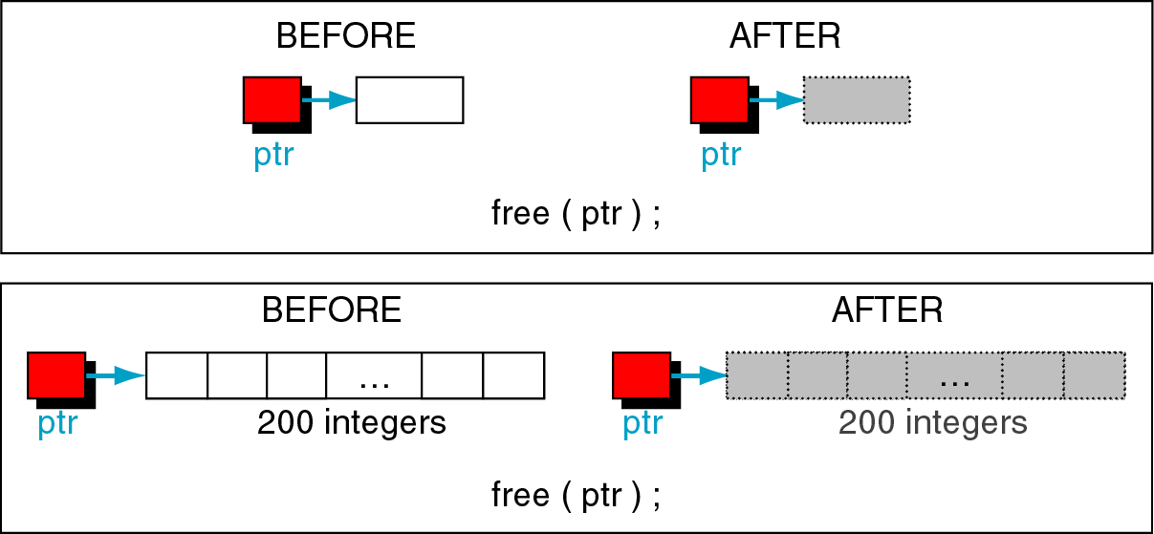
free

Slide 18
Difference between malloc and calloc
S.no | malloc() | calloc()
1 | It allocates only single block of requested memory | It allocates multiple blocks of requested memory
2 | int *ptr;ptr = malloc( 20 * sizeof(int) );For the above, 20*4 bytes of memory only allocated in one block. | int *ptr;Ptr = calloc( 20, 20 * sizeof(int) );For the above, 20 blocks of memory will be created and each contains 20*4 bytes of memory.
 | Total = 80 bytes | Total = 1600 bytes
3 | malloc () doesn’t initializes the allocated memory. It contains garbage values | calloc () initializes the allocated memory to zero
4 | type cast must be done since this function returns void pointer int *ptr;ptr = (int*)malloc(sizeof(int)*20 ); | Same as malloc () function int *ptr;ptr = (int*)calloc( 20, 20 * sizeof(int) );

Slide 19
Resizing and Releasing Memory
When your program comes out, operating system automatically release all the memory allocated by your program but as a good practice when you are not in need of memory anymore then you should release that memory by calling the function free().
Alternatively, you can increase or decrease the size of an allocated memory block by calling the function realloc().

Slide 20
Example-1
#include <stdio.h>
#include <stdlib.h>
int main(){
int n,i,*ptr,sum=0;
printf("Enter number of elements: ");
scanf("%d",&n);
ptr=(int*)malloc(n*sizeof(int)); //memory allocated using malloc
if(ptr==NULL)
{
printf("Error! memory not allocated.");
exit(0);
}
printf("Enter elements of array: ");
for(i=0;i<n;++i)
{
scanf("%d",ptr+i);
sum+=*(ptr+i);
}
printf("Sum=%d",sum);
free(ptr);
return 0;
}
Enter number of elements: 3
Enter elements of array: 2 7 1
Sum=10
Dynamic-ex1.c

Slide 21
Example - 2
#include <stdio.h>
#include <stdlib.h>
int main(){
int n,i,*ptr,sum=0;
printf("Enter number of elements: ");
scanf("%d",&n);
ptr=(int*)calloc(n,sizeof(int));
if(ptr==NULL)
{
printf("Error! memory not allocated.");
exit(0);
}
printf("Enter elements of array: ");
for(i=0;i<n;++i)
{
scanf("%d",ptr+i);
sum+=*(ptr+i);
}
printf("Sum=%d",sum);
free(ptr);
return 0;
}
Enter number of elements: 3
Enter elements of array: 2 1 3
Sum=6
Dynamic-ex2.c

Slide 22
Example - 3
#include <stdio.h>
#include <stdlib.h>
int main(){
int *ptr,i,n1,n2;
printf("Enter size of array: ");
scanf("%d",&n1);
ptr=(int*)malloc(n1*sizeof(int));
printf("Address of previously allocated memory: ");
for(i=0;i<n1;++i)
printf("%u\t",ptr+i);
printf("\nEnter new size of array: ");
scanf("%d",&n2);
ptr=realloc(ptr,n2);
for(i=0;i<n2;++i)
printf("%u\t",ptr+i);
return 0;
}
Enter size of array: 3
Address of previously allocated memory: 7474944 7474948 7474952
Enter new size of array: 5
7474944 7474948 7474952 7474956 7474960
Dynamic-ex3.c

Slide 23
Example - 4
Name = Zara Ali
Description: Zara ali a DPS student in class 10th
#include <stdio.h>
#include <string.h>
int main()
{
char name[100];
char *description;
strcpy(name, "Zara Ali");
/* allocate memory dynamically */
description = malloc( 200 * sizeof(char) );
if( description == NULL )
{
fprintf(stderr, "Error - unable to allocate required memory\n");
}
else
{
strcpy( description, "Zara ali a DPS student in class 10th");
}
printf("Name = %s\n", name );
printf("Description: %s\n", description );
}
Dynamic-ex4.c

Slide 24
Example - 5
#include <stdio.h>
#include <stdlib.h>
#include <string.h>
int main()
{
char name[100];
char *description;
strcpy(name, "Zara Ali");
/* allocate memory dynamically */
description = malloc( 30 * sizeof(char) );
if( description == NULL )
{
fprintf(stderr, "Error - unable to allocate required memory\n");
}
else
{
strcpy( description, "Zara ali a DPS student.");
}

Slide 25
Example – 5 Cont---
/* suppose you want to store bigger description */
description = realloc( description, 100 * sizeof(char) );
if( description == NULL )
{
fprintf(stderr, "Error - unable to allocate required memory\n");
}
else
{
strcat( description, "She is in class 10th");
}
printf("Name = %s\n", name );
printf("Description: %s\n", description );
/* release memory using free() function */
free(description);
}
Name = Zara Ali
Description: Zara ali a DPS student.She is in class 10th
Dynamic-ex5.c

Slide 26
Memory Leaks
A memory leak occurs when allocated memory is never used again but is not freed.
I can happen when
The memory’s address is lost
The free function is never invoked though it should be
The problem with memory leak is that the memory cannot be reclaimed and use later. The amount of memory available t the heap manager will be decreased.
If the memory is repeatedly allocated and then lost, then the program may terminate when more memory is needed but malloc cannot allocate it because it ran out of memory.

Slide 27
Example
char *chunk;
while(10
{
chunk=(char*) malloc (1000000);
printf(“allocating\n”);
}
The variable chunk is assigned memory from heap. However this memory is not freed before another block of memory is assigned to it.
Eventfully the application will run out of memory and terminate abnormally.

Slide 28
POINTER ARITHMETIC

Slide 29
Pointer Arithmetic
This section introduces the concept of pointer arithmetic, and this will form one of the very important building blocks in understanding the functionality of pointers.

Slide 30
Pointer Expressions and Pointer Arithmetic
Arithmetic operations can be performed on pointers
Increment/decrement pointer (++ or --)
Add an integer to a pointer( + or += , - or -=)
Pointers may be subtracted from each other
All these operations meaningless unless performed on an array
NOTE: Division and Multiplication are not allowed.

Slide 31
Pointer Arithmetic
int a,b,*p,*q
p=-q /* illegal use of pointers*/
p<<=1 /* illegal use of pointers*/
p=p-b /*valid*/
p=p-q /* nonportable pointer conversion*/
p=(int*) p-q /*valid*/
p=p-q-a /*valid*/
p=p+a /*valid*/
p=p+q /* invalid pointer addition*/
p=p*q /* illegal use of pointers*/
p=p/q /* illegal use of pointers*/
p=p/a /* illegal use of pointers*/

Slide 32
Pointer Increment – Example - 1
#include<stdio.h>
void main()
{
int n;
int *pn;
pn=&n;
int *pn1;
pn1=pn+1;
printf("%d %d\n", pn,pn1);
double d;
double *pd;
pd=&d;
double *pd1;
pd1=pd+1;
printf("%d %d\n", pd,pd1);
}
2686788 2686792
2686768 2686776
Arithmetic-ex1.c

Slide 33
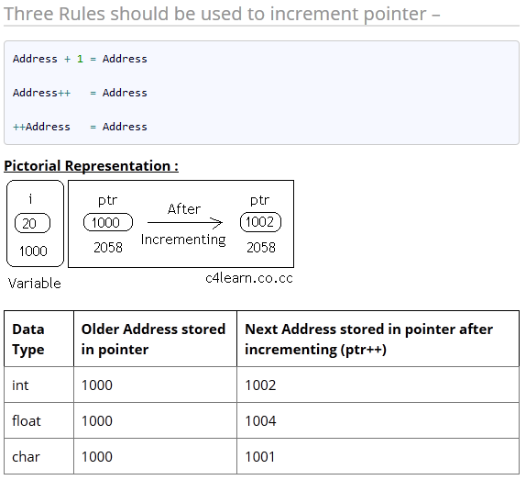
Incrementing Pointer :
Incrementing Pointer is generally used in array because we have contiguous memory in array and we know the contents of next memory location.
Incrementing Pointer Variable Depends Upon data type of the Pointer variable

Slide 34
Example – 2
#include<stdio.h>
int main()
{
int *ptr=(int *)1000;
printf(“Old Value of ptr : %u",ptr);
ptr=ptr+1;
printf("New Value of ptr : %u",ptr);
return 0;
}
Old Value of ptr : 1000
New Value of ptr : 1004
Arithmetic-ex2.c

Slide 35
Difference between two integer Pointers – Example - 3
#include<stdio.h>
int main(){
float *ptr1=(float *)1000;
float *ptr2=(float *)2000;
printf("\nDifference : %d\n",ptr2-ptr1);
return 0;
}
Difference : 250
Arithmetic-ex3.c

Slide 36
Explanation
Ptr1 and Ptr2 are two pointers which holds memory address of Float Variable.
Ptr2-Ptr1 will gives us number of floating point numbers that can be stored.
ptr2 - ptr1 = (2000 - 1000) / sizeof(float)
= 1000 / 4

Slide 37
Pointer Division – Example - 4
#include<stdio.h>
int main()
{
int *ptr1,*ptr2;
ptr1 = (int *)1000;
ptr2 = ptr1/4;
return(0);
}
Illegal Use of operator : INVALID
Arithmetic-ex4.c

Slide 38
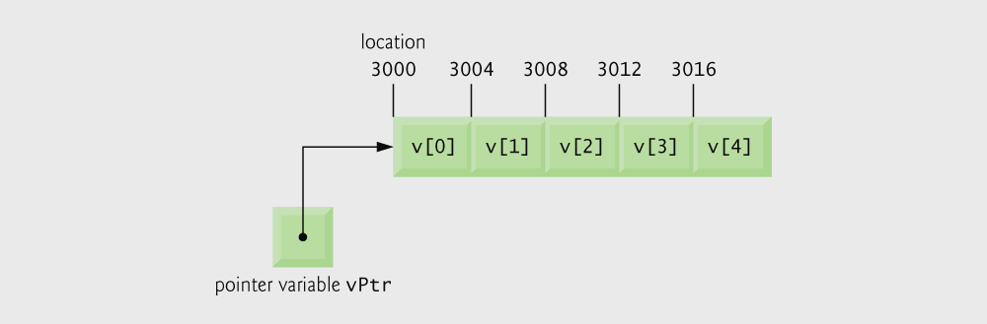
Pointer Expressions and Pointer Arithmetic-Arrays
5 element int array on machine with 4 byte ints
vPtr points to first element v[ 0 ]
at location 3000 (vPtr = 3000)
vPtr += 2; sets vPtr to 3008
vPtr points to v[ 2 ] (incremented by 2), but the machine has 4 byte ints, so it points to address 3008
Array v and a pointer variable vPtr that points to v.

Slide 39
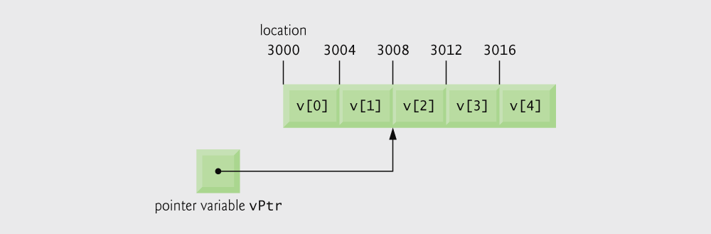
The pointer vPtr after pointer arithmetic

Slide 40
Pointer Expressions and Pointer Arithmetic
Subtracting pointers
Returns number of elements from one to the other. If
vPtr2 = v[ 2 ];
vPtr = v[ 0 ];
vPtr2 - vPtr would produce 2
Pointer comparison ( <, == , > )
See which pointer points to the higher numbered array element
Also, see if a pointer points to 0

Slide 41
The Relationship Between Pointers and Arrays
Arrays and pointers closely related
Array name like a constant pointer
Pointers can do array subscripting operations
Define an array b[ 5 ] and a pointer bPtr
To set them equal to one another use:
bPtr = b;
The array name (b) is actually the address of first element of the array b[ 5 ]
bPtr = &b[ 0 ]
Explicitly assigns bPtr to address of first element of b

Slide 42
The Relationship Between Pointers and Arrays
Element b[ 3 ]
Can be accessed by *( bPtr + 3 )
Where n is the offset. Called pointer/offset notation
Can be accessed by bptr[ 3 ]
Called pointer/subscript notation
bPtr[ 3 ] same as b[ 3 ]
Can be accessed by performing pointer arithmetic on the array itself
*( b + 3 )

Slide 43
Example - 5
Array subscript notation
Pointer/offset notation

Slide 44
Pointer subscript notation
Pointer offset notation
Arithmetic-ex5.c

Slide 47
Condition of for loop actually performs an action

Slide 48
ARRAY OF POINTERS

Slide 49
Introduction
An array of pointer is similar to an array of ant predefined data type
As a pointer variable always contain an address, an array of pointer is a collection of addresses.
These can be address of ordinary isolated variable or of array elements.
The elements of an array of pointers are stored in the memory just like elements of any other kind of array.
Example is given below..

Slide 50
Example - 1
Arraypointer-ex1.c
#include <stdio.h>
const int MAX = 3;
int main () {
int var[] = {10, 100, 200};
int i, *ptr[MAX]; //array of pointers
for ( i = 0; i < MAX; i++) {
ptr[i] = &var[i]; /* assign the address of integer. */
}
for ( i = 0; i < MAX; i++) {
printf("Value of var[%d] = %d\n", i, *ptr[i] );
}
return 0;
}
Value of var[0] = 10
Value of var[1] = 100
Value of var[2] = 200

Slide 51
Example - 2
#include<stdio.h>
void main()
{
int arr[3]={1,2,3};
int i, *ptr[3];
for(i=0;i<3;i++)
ptr[i]=arr+i;
for(i=0;i<3;i++)
printf("%p %d\n", ptr[i],*ptr[i]);
}
0028FF30 1
0028FF34 2
0028FF38 3
Arraypointer-ex2.c

Slide 52
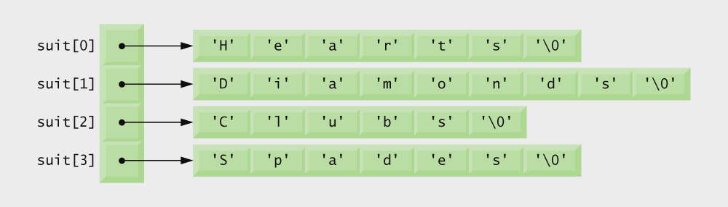
Arrays of Pointers - Strings
Arrays can contain pointers
For example: an array of strings
char *suit[ 4 ] = { "Hearts", "Diamonds", "Clubs", "Spades" };
Strings are pointers to the first character
char * – each element of suit is a pointer to a char
The strings are not actually stored in the array suit, only pointers to the strings are stored
suit array has a fixed size, but strings can be of any size

Slide 53
Case study: Roman numeral equivalents – Example - 3
#include <stdio.h>
void main( void ) {
int decimal_number = 101, a = 0, b = 0;
const char *x[11] = {"", "x", "xx", "xxx", "xl", "l", "lx", "lxx", "lxxx", "xc", "c"};
const char *y[10] = {"", "i", "ii", "iii", "iv", "v", "vi", "vii", "viii", "ix"};
while ((decimal_number > 100) || (decimal_number < 0)) {
printf("Enter the decimal numbers in the range 1 to 100:\n");
scanf("%d", &decimal_number);
}
a = decimal_number/10;
b = decimal_number%10;
printf("The equivalent roman is %s%s\n", x[a], y[b]);
}
Enter the decimal numbers in the range 1 to 100:
15
The equivalent roman is xv
Arraypointer-ex3.c

Slide 54
Review
Dynamic Memory allocation
Pointer Arithmetic
Array of pointers

Slide 55

Try it Yourself
Write a program using dynamic memory allocation to get a student’s mark and display it back.
Write a program to do the following
The process for finding a prime is quite simple. First, you know by inspection that 2, 3, and 5 are the first three prime numbers, because they aren’t divisible by anything other than 1 and themselves. Because all the other prime numbers must be odd (otherwise they would be divisible by 2), you can work out the next number to check by starting at the last prime you have and adding 2. When you’ve checked out that number, you add another 2 to get the next to be checked, and so on. to check whether a number is actually prime rather than just odd, you could divide by all the odd numbers less than the number that you’re checking, but you don’t need to do as much work as that. if a number is not prime, it must be divisible by one of the primes lower than the number you’re checking. Because you’ll obtain the primes in sequence, it will be sufficient to check a candidate by testing whether any of the primes you’ve already found is an exact divisor. Store all primes in an array using pointers and pointer arithmetic.

Slide 56
Try it Yourself
Find Largest Element Using Dynamic Memory Allocation and pointer arithmetic to access the array
Write a C program to find the sum of two 1D matrices using dynamic memory and pointer arithmetic.

Slide 57
Try it Yourself –Ans - Student mark
#include<stdio.h>
#include<stdlib.h>
void main()
{
int no, *pt,i;
clrscr();
printf("Enter no of Students :");
scanf("%d",&no);
pt=(int *)malloc(no*2);
if(pt== NULL)
{
printf("\n\nMemory allocation failed!");
exit(0);
}

Slide 58
Student mark
printf("* * * * Enter roll no of students. * * * *\n");
for (i=0;i<no;i++)
{
printf("-->");
scanf("%d",(pt+i));
}
printf("\n* * * * Entered roll no. * * * *\n");
for (i=0;i<no;i++)
{
printf("%d, ",*(pt+i));
}
}

